Slide 1
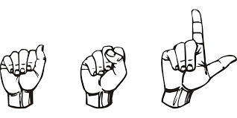
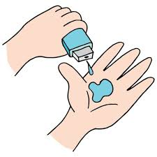
IBM Internship Project
Wizard Team
‘AI SIGN LANGUAGE RECOGNITION’
Anshuman Pratik
STU62cef4f77a0981657730295
Vellore Institute of Technology, Vellore

Slide 2
PROJECT TITLE
ASL Sign Language Recognition based on Convolutional Neural Networks

Slide 3

AGENDA
For those with hearing and speech disabilities, sign language has unquestionably emerged as the ultimate remedy and is a very effective means of expressing their thoughts and feelings to the outside world. It facilitates and simplifies the integration process between them and others. The sign language recognition steps are described in this survey. The data acquisition, data pre-processing and transformation, feature extraction, classification and results obtained are examined. The basis for our model design came from Using Deep Convolutional Networks for Gesture Recognition in Sign Language paper that accomplished a similar Sign Language Gesture Classification task .

Slide 4

PROBLEM STATEMENT
To communicate with other deaf and dumb persons or with the general public, it is most frequently utilised by these individuals. Given a hand gesture, implementing such an application that detects sign language in real time through hand gestures and allowing the user to get the accurate results of the character detected in a live video take as well as allowing such users to build their own customised gesture so that the issues faced by people who are unable to talk vocally can be accommodated with technological assistance and the barrier of expression can be overcome. Some of the key advancements in this field could be Conversion to Voice, Text, Application for help, interactive Website to help impaired people

Slide 5

PROJECT OVERVIEW
The American Sign Language letter database of hand gestures represent a multi-class problem with 24 classes of letters (excluding J and Z which require motion). The dataset format is patterned to match closely with the classic MNIST. This could make it easier for sign language users to communicate with their workplace and friends. An Image processing mechanism would combine natural language processing with computer vision, but the first step would be to precisely identify and categorise sign language signs using computer vision. In this notebook, a convolutional neural network will be used to categorise a dataset of American Sign Language alphabet hand signs. The initial stage in such an application would be to precisely identify and categorize sign language signs using computer vision. The program would also include natural language processing. In this notebook, we'll use a convolutional neural network to categorize a series of images of the alphabet in Sign Language.

Slide 6

WHO ARE THE END USERS?
To communicate with others or with people in general, deaf and dumb persons most frequently utilize sign language. Over 70 million individuals worldwide are deaf, according to the World Federation of the Deaf. Over 80% of them reside in underdeveloped nations. Sign to text conversion and voice conversion for impaired people of society is possible through this solution.

Slide 7

YOUR SOLUTION AND ITS VALUE PROPOSITION
MNSIT Datasets
Image Processing
CNN Model
Python
Google Collaboratory
When training our CNN model, the training results were 95% accurate but the validation results had an accuracy of 98%. When applying the CNN model on our test images we got the result of 98% accuracy.

Slide 8

THE WOW IN YOUR SOLUTION
The Batch Normalization and Dropout layers greatly helped in raising the accuracy, and that was the main lesson I took away from it. The training results also appeared to be significantly smoothed by the Dropout layers. This simple to interact environment for sign recognition is not only beneficial but also cost effective for impaired people. I would like to extend my gratitude to the mentors for supporting me in every step of the internship And I look forward to contributing to the IBM community!

Slide 9
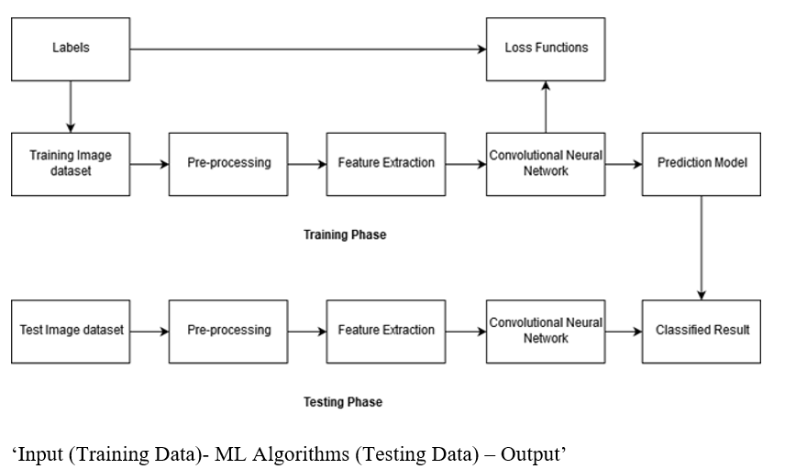
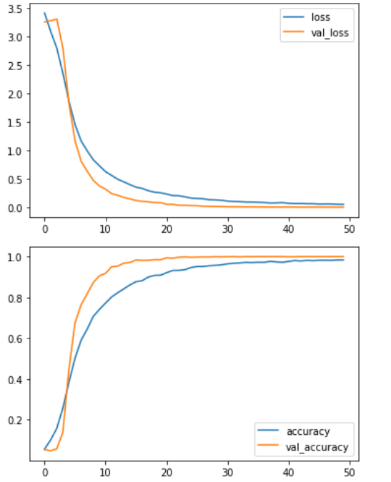
MODELLING
After the model has been trained, each test image's labels will be predicted using the pixel data from the test set. The model's performance will then be assessed by reviewing a classification report.

Slide 10
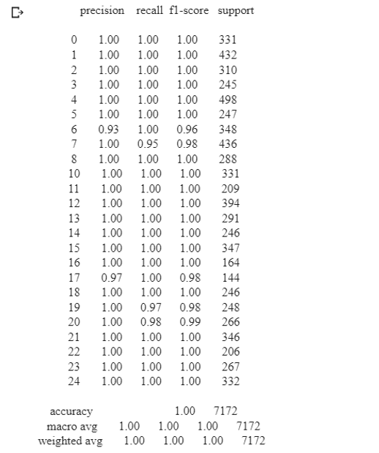
RESULTS
The problem of sign independence only serves to exacerbate all of these sign language extraction and feature engineering. Few allow for real assessments of signer independence across lengthy continuous sequences, despite bigger data sets beginning to emerge. Making data sets that are not just realistic but also adequately annotated to support machine learning may be one of the most critical concerns in SLR. Despite these issues, SLR has recently been used for translation to spoken language or, when linked with avatar technology, to another sign language. When applying the CNN model to the images of datset on our test images we could easily get 98% accuracy.
Project Link

Slide 11

MEET OUR TEAM
Anshuman Pratik [Final Year Student at VIT, Vellore]
Bassar Patel [Mentor at Edunet Foundation]
Co-ordinators
Khyati Nagpal
Anusha Tyagi
Utkarsh Sharma [Mentor at Edunet Foundation]

